Slide 1
Graph Theory 1
Introduction to graphs

Slide 2
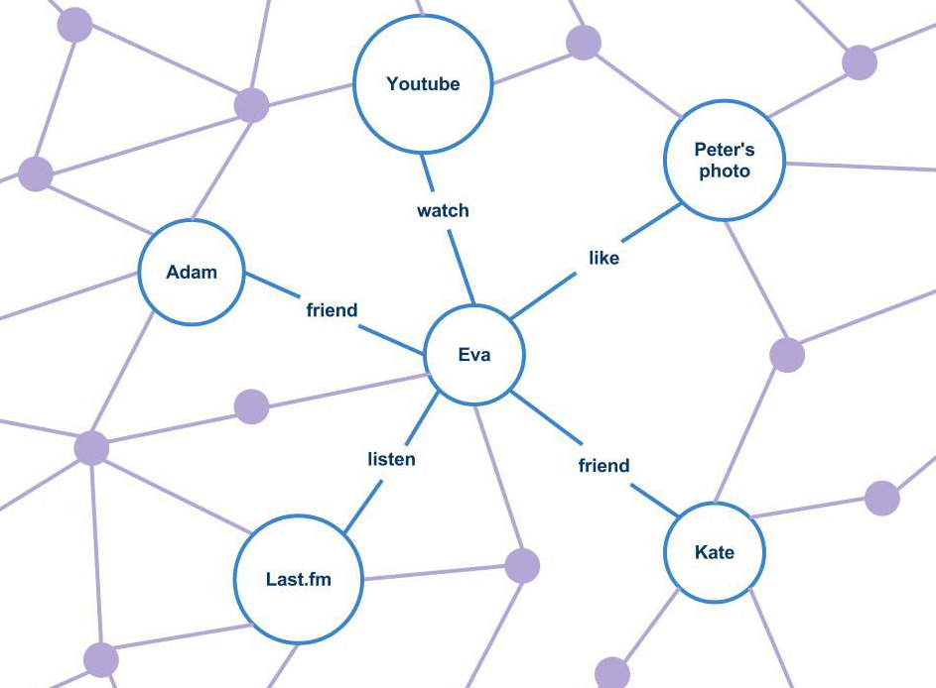
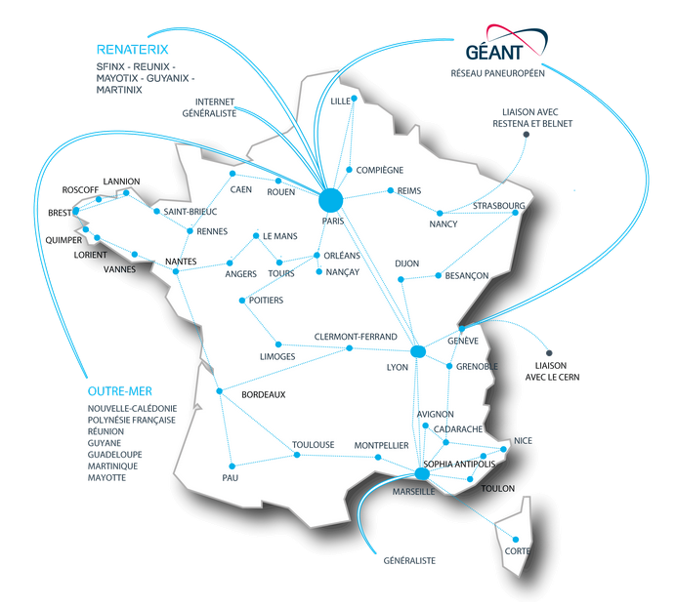
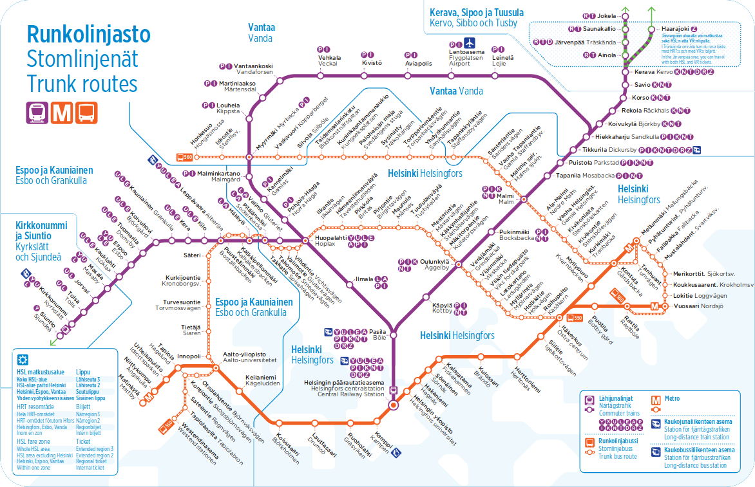
A world of graphs
Social interactions
Helsinki trains map
Renater network

Slide 3
So what’s a graph?
It’s a tuple (V, E), where
V is a set of vertices
E is a set of edges
If the edges have an orientation, the graph is directed, otherwise it is undirected

Slide 4
So what’s a graph?
1
2
Some graphs contain more information such as:
values on vertices
values on edges
7
9
3
4
3

Slide 5
How to represent a graph?
Solution #1 : edge list
Let’s label the vertices from 0 to n-1
We need to find a data structure for the edges…
What about a list of couples?
0
3
2
1
Check if i and j are neighbors
Find all neighbors of i
[(0,1),(0,2),(1,2), (2,3)]
O(|E|)
O(|E|)
→ awfully long for such simple operations

Slide 6
How to represent a graph?
Solution #2 : adjacency matrix
0
3
Another idea is to store the relations as a matrix
→ boolean, or the value on the edge if the graph has some (and a dead value like None if there is no edge between two nodes)
2
1
0 | 1 | 1 | 0
1 | 0 | 1 | 0
1 | 1 | 0 | 1
0 | 0 | 1 | 0
Check if i and j are neighbors
Find all neighbors of i
O(1)
O(n)
→ but always takes O(n²) in memory (not suitable for big graphs)
Symmetry for a directed graph

Slide 7
How to represent a graph?
Solution #3 : Adjacency list
→ store all neighbors of each node
(there is a variant with sets, they take more memory but allow quicker adjacency check)
0
3
2
1
Check if i and j are neighbors
Find all neighbors of i
{0: [1, 2],
1: [0, 2],
2: [0, 1, 3],
3: [2]}
O(|E| / n) avg
O(|E| / n) avg
→ this representation is very often preferred as it is compact and efficient

Slide 8
Just a few terms
a path is a sequence of 2-by-2 adjacent nodes and edges
a simple path is a path that has no repeated vertices and edges
a cycle is a path starting and ending at the same node
a connected component is a subgraph in which there exists a path between any two nodes but not with any external node

Slide 9
Special graphs (undirected)
acyclic graph | connected graph | tree = connected + acyclic

Slide 10
Note on directed graphs
their matrix isn’t symmetrical
being acyclic doesn’t mean that the undirected counterpart is acyclic too
there are two notions of connection for directed graphs:
weakly connected = the corresponding undirected graph is connected
strongly connected = there is a path in each direction for each pair of vertices

Slide 11
Some properties of trees...
A tree has N-1 edges for N vertices
A tree is a connected & acyclic graph
Remove any edge from the tree and it disconnects the graph
In the general case vertice can have any degree
Some trees are more specific : binary trees, k-trees

Slide 12
Slides: Louis Sugy for INSAlgo, revised in 2020 by Louis Gombert
Helsinki trains map: HSL
The Internet in 2015: The Opte Project
Renater network: Renater

